Slide 1
Rotary og Ungt Entreprenørskap v02 en kickstart for nye Rotaract-klubber og rekruttering i d2310
Guvernøren ber om å invitere og inspirere til samarbeide!
Kjetill Gunnarson, Oslo Rotary klubb
Lærer Entreprenørskap og Rotarianer
Medgründer 7 nye badminton-klubber
Ifølge «New Rotary» 2019 er RIs mål 1 million Rotaract-medlemmer i 2029
Notes:
RI Board decisions October 2019: Board minutes - October 2019
The second 2019–20 RI Board of Directors meeting was held on 21–24 October 2019 at the Rotary International World Headquarters in Evanston, Illinois, USA.
At this meeting, the Board reviewed 14 committee reports and recorded 61 decisions.
Club and District
The Board received a report on membership trends that included, as of 1 July 2019, a membership total of 1,189,466 Rotarians (down 5,641 members from 2018) and a total of 35,890 clubs (up 209 clubs from 2018).
Programs and Awards
in reviewing several recommendations from the Elevate Rotaract Task Force, agreed to
allow Rotaract clubs to organize without a sponsor
allow Rotaract clubs to organize with a Rotaract club sponsor
remove the upper age limit of Rotaract (but maintained that the program is for young adults)
strongly encourage Rotary districts to include Rotaractors in every district committee
further review establishing per capita dues for Rotaractors
eliminate the US$50 chartering fee for new Rotaract clubs, beginning 1 July 2021 (provided that a Rotaract per capita dues structure is in place)
encourage future RI presidents to appoint Rotaractors as advisers to RI committees
explore developing a mobile app to better facilitate Rotary and Rotaract club management and communications
set the following goals pertaining to Rotaract:
increase the number of reported Rotaractors by 100 percent by 2022
increase the number of reported Rotaractors that join Rotary clubs by 20 percent by 2022
increase the number of reported Rotaractors to one million by 2029.

Slide 2
New Rotary’s four parallel CHALLENGES
Show we are an organisation for “people like us”
Decreasing membership numbers
Increasing average age memberships
Imbalance voluntary organisation arenas (Friendship-Humanitarian-Networking)
Necessary Reactions
Rebranding and Rebalancing
Self-renewal Recruiting Models
Younger Members and Youth Clubs
Cross-Generational Networking/Mentoring Arenas
Covid19-pandemic
creates even larger
recruiting gaps
Notes:
Som bevegelse trenger Rotary og d2310 vekst og varige rekrutteringsmodeller

Slide 3
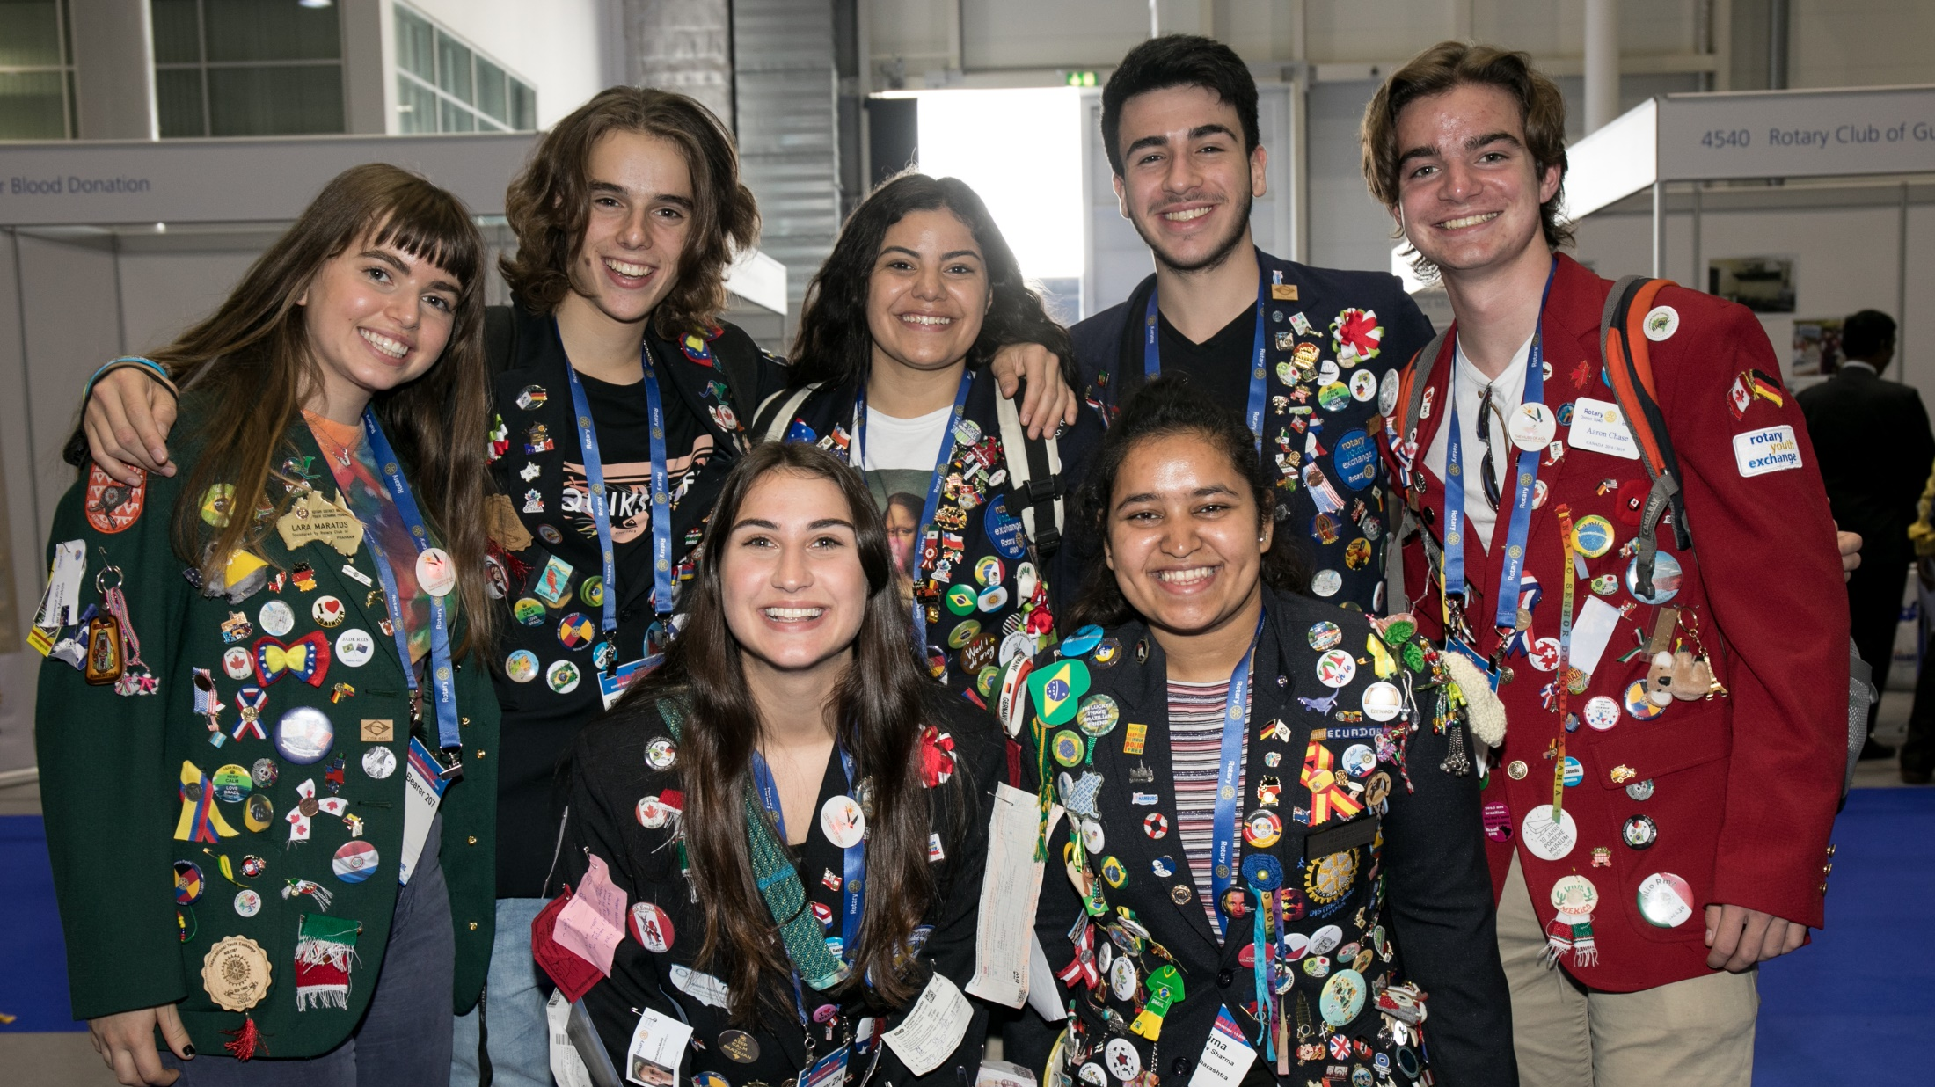
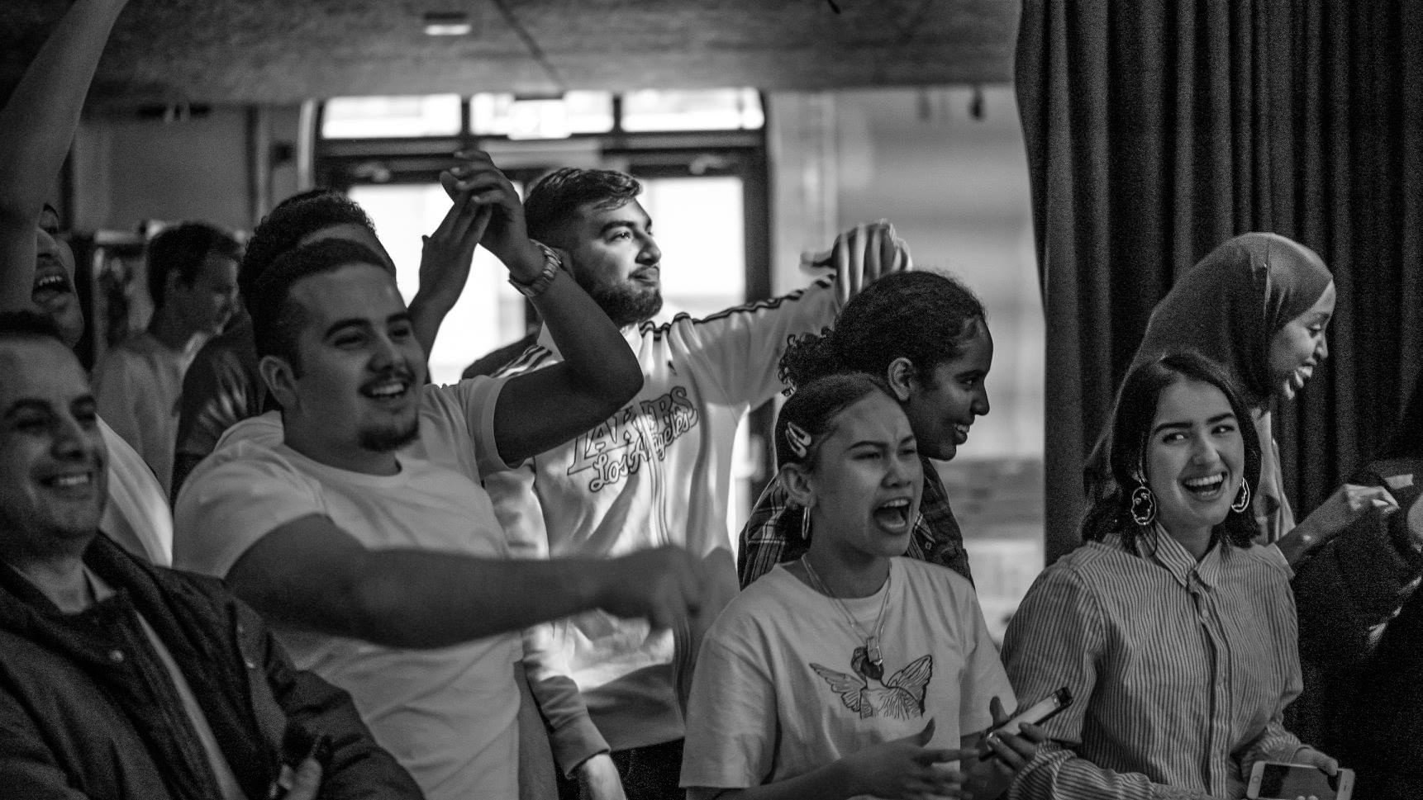
Capturing Change Makers Early
by Using Rotaract clubs and RYLA alumni
Ungt Entreprenørskap (UE)
(Junior Achievement (JA))
and UE Alumni as triggers
UNGDOMSBEDRIFT
SOLUTION:
Connecting “Change”
Service-above-Self
Generations
through Partnerships

Slide 4
VISION: “Rotary friendships from cradle to grave” in changing professional and humanitarian lives
Interact 12-18
Rotaract 19-30+
Rotary 30-100+
2310
STUDENTBEDRIFT
Rotarians’ children
UNGDOMSBEDRIFT
Rotarians’ teenagers
ELEVBEDRIFT
Rotarians’ youngsters
Notes:
Hvert år etablerer 5-10.000 16-25 åringer ungdomsbedrifter (UB) i Norge gjennom Ungt Entreprenørskap (UE).
De blir automatisk medlemmer i organisasjonen UE Alumni, men der er det ikke regelmessige medlemssamlinger.
Dette er et fantastisk rekrutteringsgrunnlag for både Rotary og Rotaract. Første skritt er å tilby Rotary-mentorer til ungdomsbedriftene. Andre skritt er at Rotary-klubber i fellesskap lager lavterskel-Rotaract-tilbud for UE Alumni-medlemmer som gjør at de blir Rotaract-medlemmer.

Slide 5
The changing world of Rotaract youths
What do Rotaract clubs do?
Learn about and develop innovative solutions to the world’s most pressing challenges
Exchange ideas with leaders in the community
Develop leadership and professional skills
Have fun through service and service projects
While making friends from around the world.
What’s involved?
Decide how to organize and run their clubs,
Manage their own funds,
Plan and carry out activities and service projects.
Rotary club sponsors offer guidance and support and work with your club as partners in service
Difference; one sponsor is no longer enough
https://www.rotary.org/en/get-involved/rotaract-clubs
Is today’s youth generation different?
Traditionally friendship groups have driven a Rotaract club for 3-10 years, before they move, have children, and/or get other priorities
During these 3-10 club years, the Rotaract club is a dominating aspect of their lives and free time
Today young people join more organisations in parallel but spend less time on each organisation
More willing to pay for outsourcing operations
Recruitment channels more work intensive
What should Rotary club sponsors do differently?
Focus youth groups annually renewing themselves
Work with Rotaract clubs as partners in service
Partner with Self-renewal Recruiting Models as JA/UE Alumni & local entrepreneurship schools
Clubs share operations weekly speakers’ corners
Regularly invite sponsored youth to own meetings
Create and follow multi-year wheel activities

Slide 6
Hensikt 1 med disse 15 minuttene på Guvernørens møte er å etterlyse flere d2310 Rotary klubber som vil starte Rotaract piloter med andre Rotary klubber og utvalgte UE Alumni og entreprenørskaps-vgs-skole partnere. Som bevegelse trenger Rotary d2310 vekst og varige rekrutteringer
Premisser pilot ny Oslo Rotaract klubb ved Sentralen.no
En sponsorperson per klubb er ikke lenger nok
Skal piloten lykkes må det være 2-3 sponsorklubber
Alle partnere tar ansvar for sin andel møtekvelder
Rotary klubb 1 – Oslo RK
Rotary klubb 2 – TBD
Rotary klubb 3 – TBD
UE Alumni Østlands-styret
Notes:
I tillegg bør man regelmessig invitere Rotaract medlemmer

Slide 7
Muligheter OECD utdannelses-scenarier, Ludvigsen-utvalget og Fagfornyelsen 2021
Flere og flere (entreprenørskaps)-skoler vil satse på
Sosialt Entreprenørskap
«i løpet av de tre årene på skolen skal utvikle ditt eget "Change Maker-prosjekt". Her får du muligheten til å velge en problemstilling som du ønsker å fordype deg i og forske på»
Økende samarbeide eksterne aktører
“Vi ønsker å bryte ned veggene til samfunnet. Derfor blir eksperter fra organisasjoner, næringsliv og høyere utdanning en viktig del av undervisningen.»
24/7 tilbud til elevene, inklusiv et mylder av kveldsklubber og aktiviteter
Kanskje kan noen av disse klubbene være Rotaract-klubber?
OECD Scenario 3
Notes:
Vil vi som bevegelsen Rotary være en del av denne læringsnav og skolepartnerskaps-trenden?

Slide 8
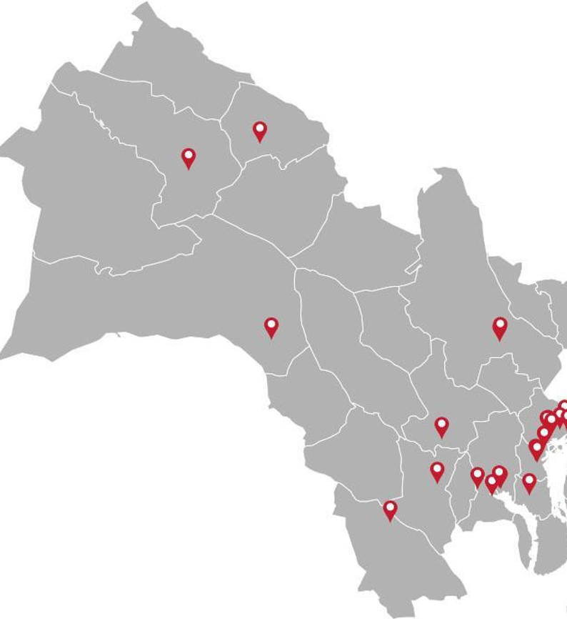
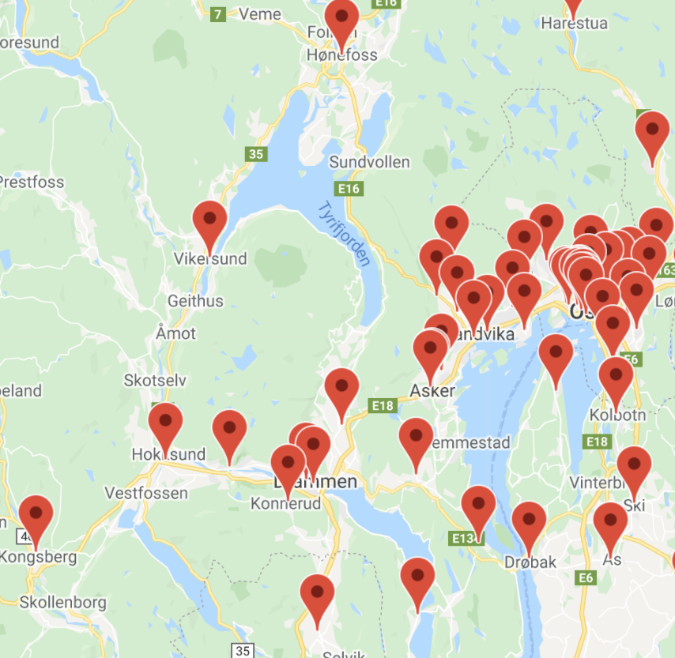
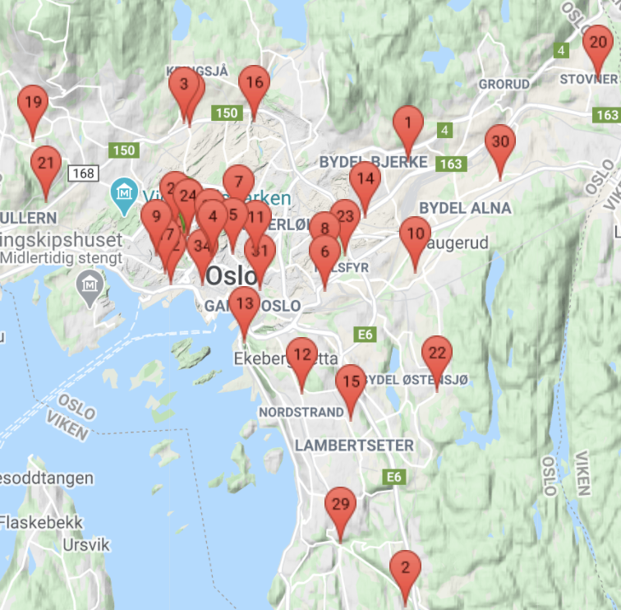
26 videregående skoler
Asker og Bærum,
Buskerud
Eksisterende:
Kristiania RK
-Deichmanske
-Elvebakken/H20
Ønsket pilot:
Oslo RK
-Sentralen.no
-UE Alumni
-Vika vgs/OHG
Mulige Oslo:
-Kongshavn/
Lambertseter
-Ullern
-Stovner/Bjerke
Mulige A&B:
-Sandvika
-Asker
Mulige Buskerud:
-Drammen
-Kongsberg
-Hønefoss
Uansett piloter, bør alle klubber regelmessig invitere VGS-elever.
Bedre langsiktig mf finnes ikke ;-)
26 videregående skoler Oslo
49 Rotary klubber district 2310
Notes:
Listen er basert på ekstisterende vgs-skoler med sterkt entreprenørskapsfokus over tid

Slide 9
Hensikt 2 er å foreslå nye Rotaract klubber med UE Alumni og VGS- partnerskap som hovedtema på d2310 RYLA 2022 Videre bør majoriteten av de inviterte ha UE Alumni og/eller VGS-bakgrunn entreprenørskapfag Som bevegelse trenger Rotary d2310 vekst og varig rekruttering
Hensikt 3 er å anbefale alle d2310 Rotary klubber å rekruttere entreprenørskapslærere fra videregående skole
For lærerne sitter på en årlig selv-fornyende
ungdomsgruppe med potensielle fremtidige Rotary og Rotaract medlemmer
Notes:
Utgangspunktet er at et nytt nasjonalt styre i Ungt Entreprenørskap Alumni (UEA) ønsker møte med Rotary
Siste email: «Det var kjipt at RYLA ble avlyst, vi så veldig frem til det. Håper vi får til noe lignende senere!
Vi håper Rotary vil fortsette samtalen med UEA og kan gjerne ta et digitalt møte med deg og evt. beslutningstagere hvis dette skulle være ønskelig om hvordan vi kan samarbeide og hva vi kan tilby hverandre.»
Vi var nesten i mål både i RYLA og PETS våren 2020 og delvis 2021, men må nå restarte igjen.

Slide 10
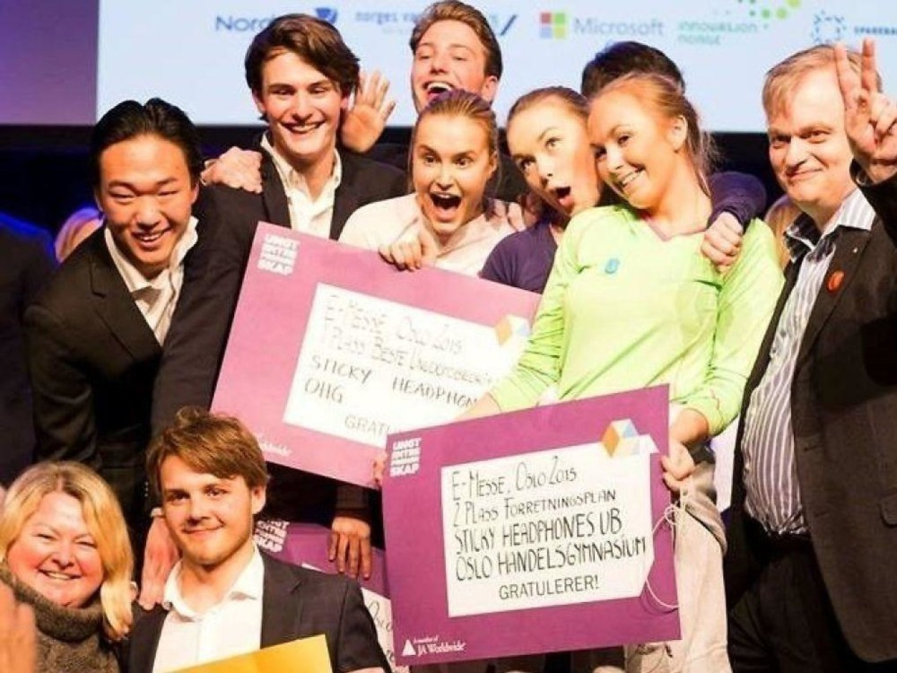
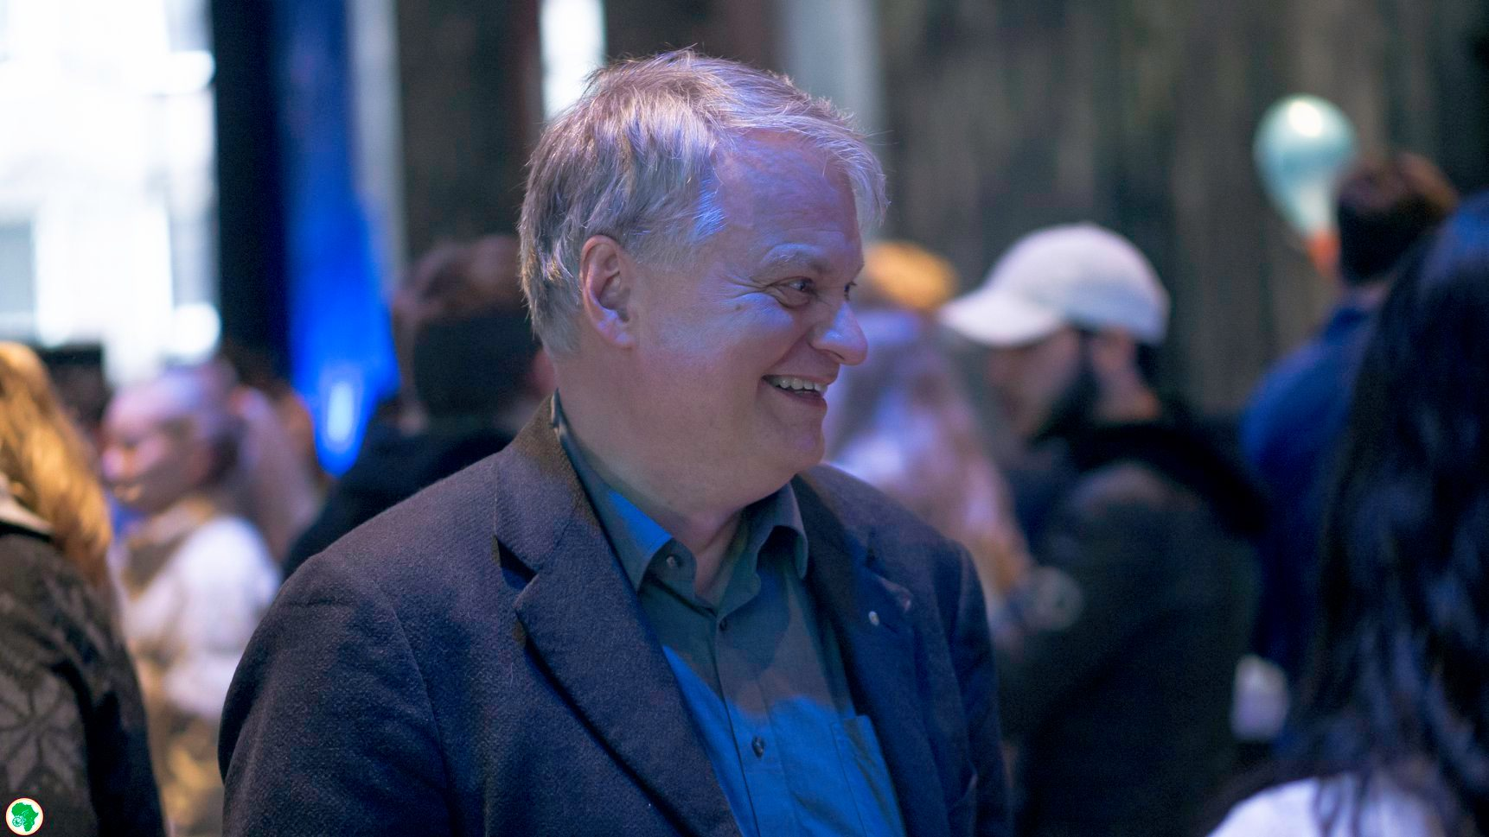
Mer informasjon
Kjetill Gunnarson, Oslo Rotary klubb
Kjetill.gunnarson@outlook.com
9755 5179
https://www.linkedin.com/in/kjetill-gunnarson-18195111/
https://www.youtube.com/watch?v=T49ppN2QATc&t=2173s&ab_channel=H20VGS
Fremtidige Rotary medlemmer ;-) nå 25 år, da 18 år

Slide 11
Vedlegg 1.Neste skritt NORFO, distrikt, og klubb 2.Rotary as a voluntary organisation 3.All of Rotary in only five slides

Slide 12
1.Neste skritt NORFO, distrikt, og klubb (Draft-versjoner)

Slide 13
Next steps at Rotary Norway level (draft)
Rotary Norge/NORFO creates partnership with JA/UE nationally
Rotary Norge/NORFO funds national ethics prize JA/UE
Rotary Norge/NORFO populates a Rotaract partnership committee, and/or expands the role of the present RYLA/Youth committees
Rotary Norge/NORFO aims offerings of Short Term Youth Exchange and marketing channels towards Rotaract/UE Alumni candidates
LONGTERM AIMS INCLUDING RI-LEVEL
Co-Fund JA Country Alumni Co-Ordinator (perhaps with Ferd/Ashoka)
Recruit to Rotary clubs from RYLA and Rotaract/JAA/school clubs
Add and fund Junior Achievement as a RI global partner, step by step connecting the UN SDG goals with RI 6 focus areas

Slide 14
Next steps at Rotary District level (draft)
Rotary district creates partnerships with JA/UE regions
Rotary district funds regional ethics prizes JA/UE
Rotary district populates a Rotaract partnership committee, and/or expands the role of the present RYLA/Youth committees
Rotary district challenges city clubs to co-sponsor Rotaract/UE Alumni clubs
Rotary district challenges clubs to co-sponsor Rotaract/school evening clubs
Rotary district dedicates RYLA 2022 primarly for UE/UB-alumni candidates, aiming to recruit them into the newly created Rotaract pilot clubs

Slide 15
Next steps at Rotary Club level (draft)
Rotary district creates partnerships with JA/UE regions
Rotary club adopts junior and high (entrepreneurship) schools
Rotary club recruits high school entrepreneurship teachers
Rotary club offers annual UB-mentors UE-company-competitions
Rotary club offers annual judges for multiple UE-competitions
Rotary club offers annual mentors for multiple UE-gatherings
Rotary club offers Short Term Youth Exchanges to their Rotaractians

Slide 16
2.Rotary as a voluntary organisation

Slide 17
Why join a voluntary organisation?
Friendship
Arenas
Humanitarian Arenas
Regular Learning- & Development Arenas
Networking Arenas
You are what you do regularly
in the following five arenas
private life,
professional life,
young people's lives,
community life, and
internationally
In short, the meaning of life are the stories you tell your grandchildren
Voluntary organisations offer
A Common Core of Regular Learning & Development arenas
Sports clubs, service organisations, NGOs
Selected Friendship arenas
Selected Humanitarian arenas
Selected Networking arenas

Slide 18
Why join a service organisation as Rotary? or How to be Everything for Everybody /Alt for Alle?
Friendship
Arenas
Humanitarian Arenas
Regular Learning- & Development Arenas
Professional Networking Arenas (yrkesnettverk)
No one voluntary organisation impacts more parallel arenas within
private life,
professional life,
young people's lives,
community life, and
internationally
than Rotary International/Districts/Clubs
Rotary clubs offer their Core of Regular Learning & Development Arenas
Weekly Speakers’ Corners
“Norway’s next best lectern”
“Counteracts narrow-mindedness and idiocy”, Erling Storrusten
Multiple Friendship arenas
Committee and Project Group meetings
Multiple Humanitarian arenas
Peace, UN UDHR, UN SDG growth, polio, local causes
Multiple Networking arenas
Professional networking and recruiting across all age groups

Slide 19
Remember the limitations of Triple Constraints in designing next year’s Rotary organisational structures
SCOPE
COST
QUALITY
TIME
Friendship
Arenas
Humanitarian Arenas
Regular Learning- & Development Arenas
Professional Networking Arenas (yrkesnettverk)
Parallels from Project Management Triangle
Prioritising one arena constrains the others

Slide 20
Challenge to next years Rotary leader teams
Secure
The Core of Regular Learning & Development arenas
Weekly Speakers’ Corners
Balance
Friendship arenas
Not only for pensioneers
Humanitarian arenas
New Rotary’s vision
Professional Networking arenas
Across “Change” Service-above-Self Generations
Avoid one or two arena perspectives dominating the totality
For many clubs/districts this is a growing risk, especially friendship
Recognise the need for regular pendulum swings between all 3 perspectives
Given Covid19’s recruiting gaps, the coming swing should be networking/mentoring, i.e. Cross-Generational Networking/Mentoring Arenas including new Rotaract Club partnerships
This may even be a survival strategic issue for Rotary as an world leading voluntary organisation
At the same time, always Remember “In Rotary’s house there are many rooms”

Slide 21
“New Rotary” Strategies og en-sides oppsummering på norsk Hvorfor bli medlem av Rotary og Rotaract? eller 3.All of Rotary in only five slides

Slide 22
N e w R o t a r y

Slide 23
Rotarys Historical Principles and New Action Plan
https://my.rotary.org/en/guiding-principles
https://my.rotary.org/en/learning-reference/about-rotary/our-priorities
https://my.rotary.org/en/learning-reference/about-rotary/strategic-plan
Historical Guiding Principles since 1905
For more than 100 years, Rotarys guiding principles have been the foundation upon which our values and tradition stand. Object of Rotary, The Four-Way Test, & Avenues of Service express our commitment to our values
service,
fellowship,
diversity,
integrity, and
leadership.
These principles have been developed over the years to provide Rotarians with a strong, common purpose and direction. They serve as a foundation for our relationships with each other and the action we take in the world. Gradually six Areas of Focus maximised impacts, while our Mottos evolved.
Four Objects of Rotary
The Object of Rotary is to encourage and foster the ideal of service as a basis of worthy enterprise and, in particular, to encourage and foster:
FIRST: The development of acquaintance [friendship] as an opportunity for service;
SECOND: High ethical standards in business and professions; the recognition of the worthiness of all useful occupations; and the dignifying of each Rotarian’s occupation as an opportunity to serve society;
THIRD: The application of the ideal of service in each Rotarian’s personal, business, and community life;
FOURTH: The advancement of international understanding, goodwill, and peace through a world fellowship of business and professional persons united in the ideal of service.
The Four-Way Test of Rotarians
The Four-Way Test is a nonpartisan and nonsectarian ethical guide for Rotarians to use for their personal and professional relationships. The test has been translated into more than 100 languages, and Rotarians recite it at club meetings: Of the things we think, say or do
Is it the TRUTH?
Is it FAIR to all concerned?
Will it build GOODWILL and BETTER FRIENDSHIPS?
Will it be BENEFICIAL to all concerned?
Five Avenues of Service of Rotary Clubs – started as four
We channel our commitment to service at home and abroad through 5 Avenues of Service, the foundation of club activity.
Club Service focuses on making clubs strong. A thriving club is anchored by strong relationships and an active membership development plan.
Vocational Service calls on every Rotarian to work with integrity and contribute their expertise to the problems and needs of society. Learn more in An Introduction to Vocational Service and the Code of Conduct.
Community Service encourages every Rotarian to find ways to improve the quality of life for people in their communities and to serve the public interest. Learn more in Communities in Action: A Guide to Effective Projects.
International Service exemplifies our global reach in promoting peace and understanding. We support this service avenue by sponsoring or volunteering on international projects, seeking partners abroad, and more.
Youth Service recognizes the importance of empowering youth and young professionals through leadership development programs such as Rotaract, Interact, Rotary Youth Leadership Awards, and Rotary Youth Exchange.
Six Areas of Focus for our Social Change Projects
We direct our efforts in six areas to enhance our local and global impact. Our most successful & sustainable projects and activities tend to fall within the following areas: Learn more
Promoting peace
Fighting disease
Providing clean water
Saving mothers and children
Supporting education
Growing local economies
Rotarys Mission
We provide service to others, promote integrity, and advance world understanding, goodwill, and peace through our fellowship of business, professional, and community leaders.
Two Mottos of Rotary
Service Above Self (principal motto since 1989)
best conveys philosophy of unselfish volunteer service
One Profits Most Who Serves Best (since 2010)
New Change Leadership starts
The world today is not the same as when Rotary began in 1905. Demographics have shifted, the pace of change is accelerating, and technology has created new opportunities for connection and service. What hasn’t changed is a need for the values that define Rotary. With our new plan, we will honor our past and embrace our future. The collective leadership and expertise of 1.2 million members will help us tackle some of the world’s biggest challenges, locally and globally. We are united by common values and vision as we sharpen our focus with targeted specific causes that reach communities most in need.
Rotary’s new Vision Statement from June 2017
“Together, we see a world where people unite and take action to create lasting change – across the globe, in our communities, and in ourselves.”
Together People Create Change
Over one million people across the world were asked to share their insights with the Strategic Planning Committee through surveys and focus groups. The vision was approved by the Rotary Board of Directors and Board of Trustees in June 2017.
Rotary’s new Action Plan from June 2018
More than a century ago, we pioneered a new model of service leadership grounded in person-to-person connections. Today, those connections are a network that spans the globe—bridging cultural, linguistic, generational, and geographic barriers—and shares the vision of a better world.
As People of Action, we understand that fulfilling that vision requires a plan. These are Rotary’s priorities for five next years:
A.IMPACT: to increase our impact (3 objectives)
B.REACH: expand our reach (4 objectives)
C.ENGAGE: enhance participant engagement (4 objectives)
D. ADAPT: increase our ability to adapt (3 objectives)
Rotary’s People of Action and their Competences
As People of Action, we share a strong sense of purpose.
A.IMPACT: We are effective problemsolvers
B.REACH: We activate and inspire one another
C.ENGAGE: We strive to understand the needs of others
D. ADAPT: We are inventive, entrepreneurial & resilient
i.e.: [Together Rotarians Co-Create and Co-Mobilize Change]

Slide 24
Challenges for Rotary today
“We surveyed 1 million plus in 15 countries if they had heard of Rotary and found out that our global awareness is outstanding: in fact, three out of four people surveyed were aware of Rotary. Among the world’s leading social service organizations, we’re in the top 3 in terms of awareness. And people know enough about us to know that we do good in the world. Now for the challenges.
Most had only a vague idea of exactly how we do good in the world. Only 35 percent saw Rotary as an organization for “people like them.”
And just 25 percent of people surveyed said they knew someone in Rotary. All of us here know how this is playing out in real life. Membership has dropped as much as 18 percent in North America and elsewhere. We set a record in 2018 for the number of people who left Rotary.
As we move closer to polio eradication, we wonder:
What are the new stories that will unite us, motivate us, and tell the rest of the world about our impact?
Where is the next generation of leadership coming from?
We’re in the midst of a huge demographic shift, but while the rising generations share our passion for community and for making a difference, they have plenty of other places to go to channel that passion—on their phones and in the real world.
So, here’s where we are today: we’re the undisputed pioneer of service leadership grounded in person-to-person connections—and yet we find, increasingly, people are not coming to us to make those connections. I know this isn’t easy to hear. But I have good news: We have a plan.”
https://my.rotary.org/en/learning-reference/about-rotary/strategic-plan

Slide 25
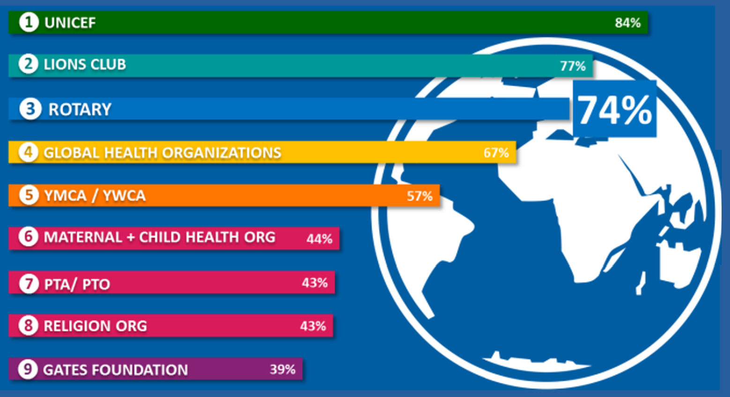

Slide 26
Hvorfor bli medlem av Rotary og Rotaract?
“Change” Services above Self
Hvorfor involvere seg? Purpose | Hva gjør vi i klubbene? Programs | Hvordan endrer vi verden? Causes | Verdi for enkeltmedlemmet? Reputation
Vi ser sammen en verden der folk forenes | Vi arrangerer regelmessige klubbmøter og sosiale samlinger | Klubbtjenester ukentlige møter og prosjektkomiteer | Vi bygger vennskap, yrkes-nettverk og sosial kapital
der vi aktivt skaper varige endringer | Vi inviterer foredragsholdere og egne utviklingstalere | Yrkestjenester livslang bredde kunnskap og almenndannelse | Vi bygger intellektuell, kulturell og etisk kapital
verden over, i våre samfunn og i oss selv | Vi utdanner ungdom(sledere) og egne ledertalenter | Ungdomstjenester utdanning, coaching, mentoring, sponsoring | Vi betaler tilbake gjennom pay-forward-prinsippet
Kort sagt: Vi gagner andre og vi utvikler oss selv | Vi prosjektleder lokale og globale humanitære endringer | Samfunnstjenester lokale humanitære profileringer | Vi løser noen av verdens mest presserende utfordringer
i privatliv, yrkesliv, unges liv, samfunnsliv, og internasjonalt | Vi rekrutterer endrings-partnere og egne medlemmer | Internasjonale tjenester fred, FN UDHR/SDG, polio, vekst | Sammen betyr våre globale partnernettverk endringsmakt
(Kjetill Gunnarson, 2020)

